Slide 1
Generative AI for Decarbonization
Contributors: Andy Vu, Seshu Mallina, Govardhan

Slide 2

Urgent Need
Unchecked carbon emissions result in rising global temperatures, extreme weather events, sea levels rising, and ecological disruptions.
By actively participating in decarbonization efforts, individuals, communities, businesses, and governments aim to mitigate these risks, preserve the natural environment, and create a sustainable future.
Decarbonization is crucial for averting the worst effects of climate change and safeguarding the planet's habitability.

Slide 3
Societal Benefits
Decarbonization brings numerous societal benefits, including improved air quality, enhanced public health, and reduced dependency on finite fossil fuel resources.
It drives innovation and economic opportunities, as the transition to clean energy and sustainable practices creates jobs and fosters the development of new technologies and industries.
Furthermore, decarbonization helps build resilient communities and promotes social equity by ensuring access to affordable and clean energy for all, regardless of socioeconomic status or geographical location.

Slide 4
Infosys' Sustainability Goals
Employee Engagement: Infosys actively engages its employees in sustainability initiatives through awareness campaigns, training programs, and employee-driven projects. This helps foster a culture of environmental responsibility and sustainability throughout the organization.
Social Responsibility: Infosys is committed to social responsibility initiatives, including education and skill development programs, community engagement, and diversity and inclusion initiatives. These efforts align with the principles of corporate social responsibility (CSR) and contribute to the social well-being of communities.
Energy Efficiency Measures: Infosys has implemented energy-efficient technologies and practices across its operations, including the use of energy-efficient data centers, LED lighting, and smart building management systems.

Slide 5
Our Solution

Slide 6
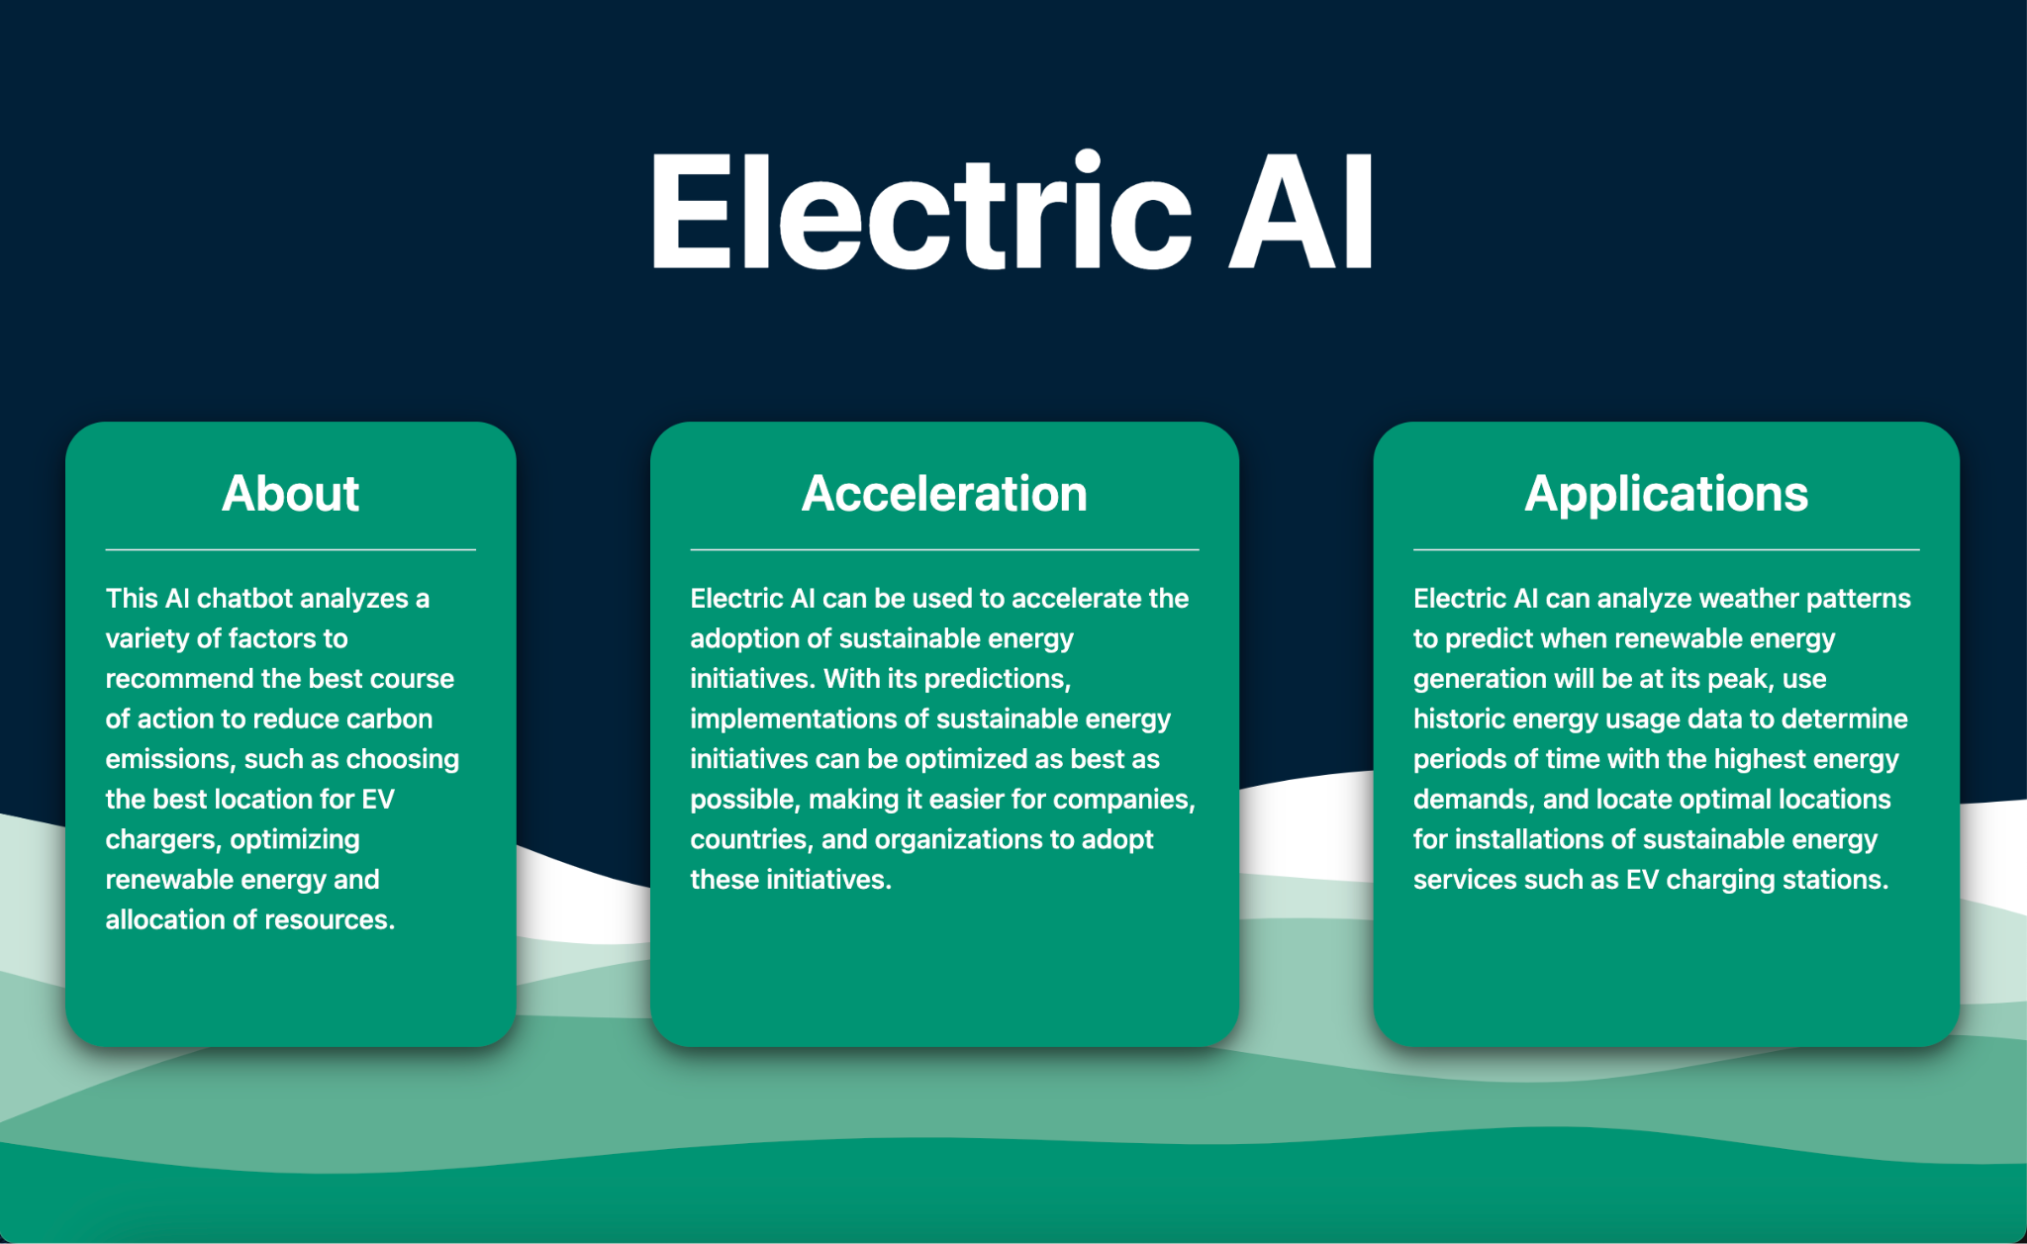

Slide 7
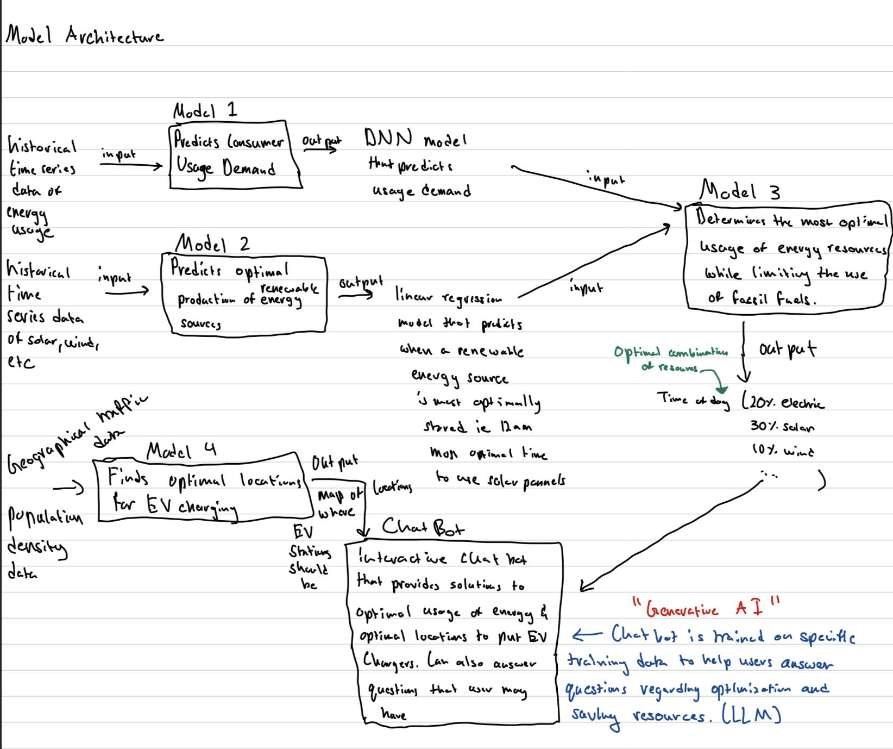
Model Architecture

Slide 8
Meeting Project Criteria

Slide 9
Predictive Model Training
Takes into account time, season, and events
Utilizes PJM's dataset for accurate predictions
Analyzes historical consumption patterns
Makes accurate predictions of high/low demand
Integrates with chatbot for real-time recommendations

Slide 10
Checkpoint 1: Energy Mix + Grid Flexibility
Using historical hourly average energy usage in a variety of regions, we trained a DNN model to predict energy demand for certain time points
The predictions of this model will combine with other models’ predictions to best optimize where and when renewable energy should be allocated
Places that are predicted to require more energy at specific times will be supplied with more renewable energy

Slide 11
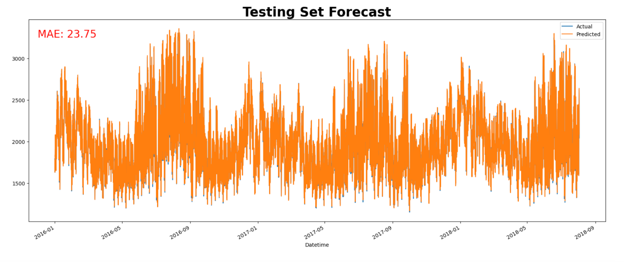
Model Accuracy

Slide 12
Checkpoint 2: EV Infrastructure Optimization
Conceptually, data regarding EV demographics of certain locations, traffic routes, and EV charging station usage will be analyzed in order to determine the best spot to build EV charging stations
Locations with high traffic and a high number of EVs would be the most optimal
By building EV charging stations in convenient areas, people are more likely to use EVs which will reduce vehicular carbon emissions

Slide 13
Checkpoint 3: The need for longer-term backup capacity
By training the AI model on this dataset, we can accurately predict future power generation from the solar plants.
This enables us to anticipate periods of high or low solar energy availability, which is crucial for planning backup capacity.
For instance, if the AI model predicts a period of low solar power generation due to cloudy weather or other factors, it alerts the chatbot and prompts recommendations for alternative energy sources or backup systems to be activated during that period.
Our dataset only included inly solar data but the model can also be replicated on other forms of renewable energy

Slide 14
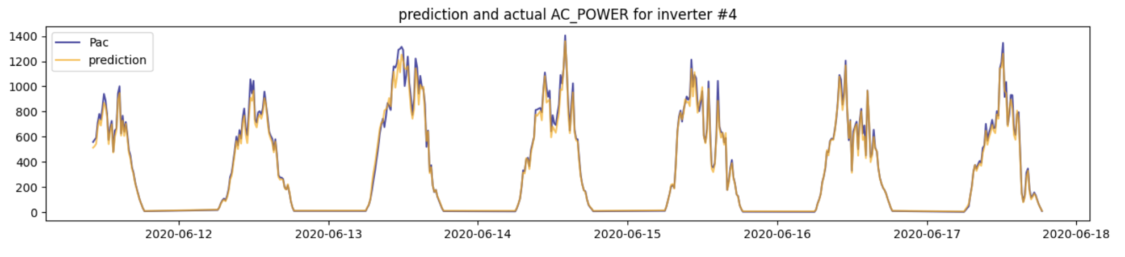
Model Accuracy

Slide 15
Purpose of Chatbot

Slide 16
Chatbot Benefits for Infosys
Identifying peak energy usage patterns and optimizing renewable energy utilization
Suggesting energy-saving practices for Infosys' facilities
Determining optimal locations for EV charging stations based on traffic patterns and population density

Slide 17
Real-Time Interaction with Chatbot
The chatbot interacts with users in real-time, providing information and suggestions based on the AI model's predictions.
It can suggest the activation of backup systems or advise on energy conservation measures during periods of reduced solar power generation.
By incorporating these predictions and recommendations into the chatbot's functionality, we enable electrical companies to plan for and manage longer-term backup capacity effectively.

Slide 18
Business Model

Slide 19
Market Analysis
Defense organizations and the airplane industry are embracing sustainability initiatives and seeking solutions that optimize their energy usage while transitioning to alternative energy resources.
The market for energy optimization and decarbonization solutions is experiencing significant growth due to rising environmental concerns and increased regulatory pressures.
Electrical companies are under increasing pressure to reduce their carbon footprint and transition to clean energy sources.
Our solution aligns perfectly with the market needs as it offers a comprehensive platform that addresses the specific challenges faced by these industries.
By providing accurate predictions of energy demand, optimizing renewable energy utilization, and suggesting optimal EV charging station locations, our solution enables customers to make informed decisions that reduce emissions, improve efficiency, and align with their sustainability goals.

Slide 20
Product Differentiation
Our solution stands out from existing offerings through its advanced AI capabilities, customization options, and real-time optimization features.
The chatbot's integration with predictive models and optimization algorithms provides valuable insights tailored to customers' specific needs.
The ability to predict energy demand, suggest optimal renewable energy utilization, optimize EV charging station locations, and address backup capacity requirements sets us apart from competitors.
The customization options offered by our solution allow customers to tailor the chatbot's recommendations and insights to their specific requirements. This flexibility ensures that the solution can adapt to different energy infrastructures and unique operational demands, making it a highly desirable choice for electrical companies, defense organizations, and the air plane industry.
Moreover, our solution's user-friendly interface and interactive nature enhance customer experience and ease of adoption.

Slide 21
Customer Acquisition
Demonstrations of AI solution's effectiveness
Targeted marketing campaigns
Partnerships with industry leaders
Motivation for adopting our solution: decarbonization goals, energy efficiency, and reduced operational costs
Optimization of transition to alternate energy resources

Slide 22
Benefits for Customers
Improved energy efficiency
Reduced carbon emissions
Reduced operational costs
Real-time optimization capabilities
Improved grid stability and flexibility

Slide 23

Revenue Model and Financial Projections
Subscription based pricing structure
Tailored to requirements of each customer
Additional revenue streams may include customization services, data analytics insights, and value added features
Based on anticipated customer acquisition rates, average subscription fees, and cost analysis
Steady increase in revenue with expanding market presence
Investments allocated to research and development, marketing, talent acquisition, and infrastructure development

Slide 24
Thank you for listening. Please feel free to ask any questions. 😄

